Slide 1
CS 513 Geospatial Vision and Visualization
Project 2 : Investigate the misalignment between Point Cloud and perspective image
Submitted to:
Prof. Xin Chen
Submitted by:
PRANAV SAI DEENUMSETTI A20370660
KARTHIK N V A20381713
DHEERAJRAM CHANDRA A20376500
SAPTARSHI BANERJEE A20376116

Slide 2
Aim:
To Investigate the misalignment between the Point cloud and the perspective image.

Slide 3
Objectives:
To process the given project data file and process the given LLA (Latitude Longitude Altitude) into ECEF (Earth Centered Earth Fixed) using co-ordinate transformations.
To convert the obtained ECEF to ENU using the given co-ordinate transformations.
To convert the then obtained ENU to Camera co-ordinates which is later converted to the image co-ordinates.
To calculate the misalignment angle(ϴ) between the point cloud image and the given image.

Slide 4
Flow of the Project:
Input data →
LLA →
ECEF →
ENU →
Camera Coordinate →
Image Coordinates
Misalignment
→

Slide 5
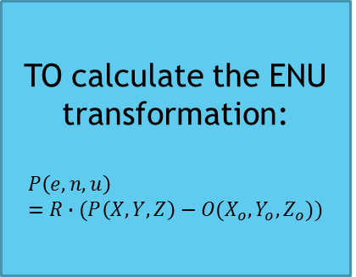
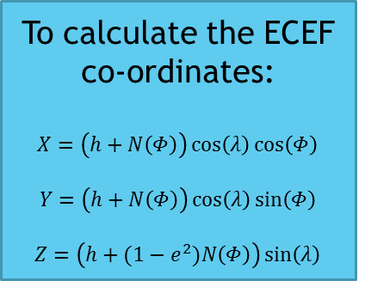
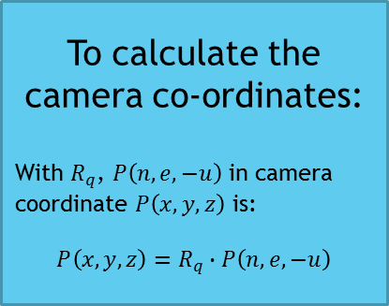
Understanding The Project:
To calculate the ECEF co-ordinates:
$$X=\left(h+N\left(Φ\right)\right)\cos\left(λ\right)\cos\left(Φ\right)$$
$$Y=\left(h+N\left(Φ\right)\right)\cos\left(λ\right)\sin\left(Φ\right)$$
$$Z=\left(h+(1−e^{2})N\left(Φ\right)\right)\sin\left(λ\right)$$
Extracting face from camera parameters:
Z>0, z>|x|, z>|y|
Then it is front face.
(for example)
Calculating the image co-ordinates:
Z>0, z>|x|, z>|y|
Then it is front face.
(for example)
TO calculate the ENU transformation:
$$P\left(e,n,u\right)=R∙(P\left(X,Y,Z\right)−O(X_{o},Y_{o},Z_{o}))$$
To calculate the camera co-ordinates:
With $R_{q}$, $P\left(n,e,−u\right)$ in camera coordinate $P\left(x,y,z\right)$ is:
$$P\left(x,y,z\right)=R_{q}∙P\left(n,e,−u\right)$$
Calculate the Misalignment:
Using OpenCV feature matching

Slide 6
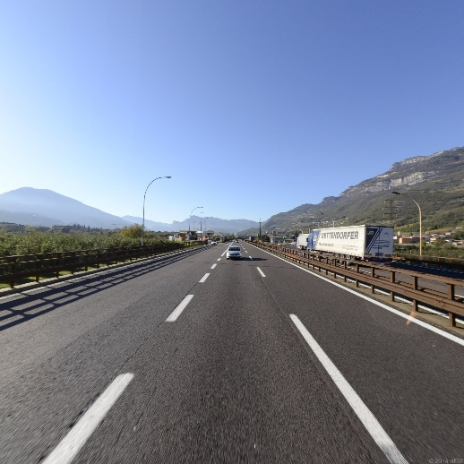
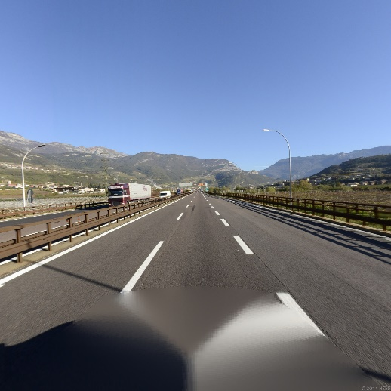
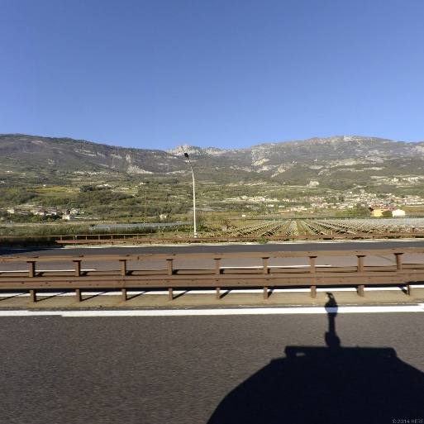
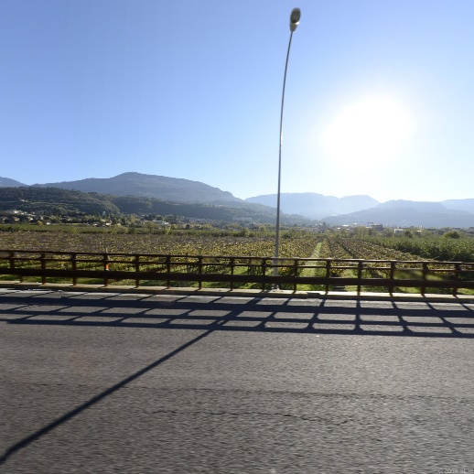
Input: Given a Point Cloud file and camera parameters
Back Front Left Right
Camera Parameters:
45.90414414, 11.02845385, 227.5819, 0.362114, 0.374050, 0.592222, 0.615007

Slide 7
What is a Point Cloud?
A point cloud is a data structure used to represent a collection of multi-dimensional points and is commonly used to represent three-dimensional data.
The points usually represent the X, Y, and Z geometric coordinates of a sampled surface.

Slide 8
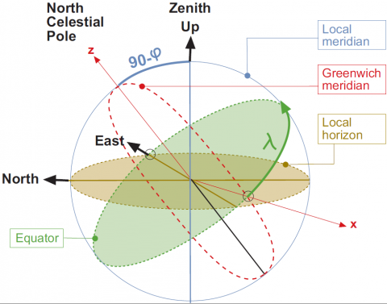
The relation between the East, North, Up (ENU) coordinates and the Earth Centered Earth Fixed (ECEF) coordinates is illustrated in the next figure:

Slide 9
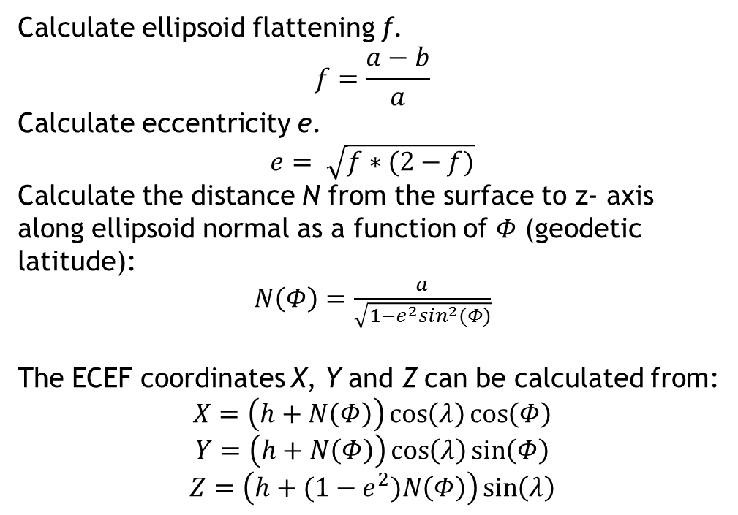
Coordinate Transformations: LLA → ECEF:-
Calculate ellipsoid flattening f.
$$f=\frac{a−b}{a}$$
Calculate eccentricity e.
$$e= \sqrt{f∗(2−f)}$$
Calculate the distance N from the surface to z- axis along ellipsoid normal as a function of 𝛷 (geodetic latitude):
$N\left(Φ\right)=\frac{a}{\sqrt{1−e^{2}\sin^{2}(Φ)}}$
The ECEF coordinates X, Y and Z can be calculated from:
$$X=\left(h+N\left(Φ\right)\right)\cos\left(λ\right)\cos\left(Φ\right)$$
$$Y=\left(h+N\left(Φ\right)\right)\cos\left(λ\right)\sin\left(Φ\right)$$
$$Z=\left(h+(1−e^{2})N\left(Φ\right)\right)\sin\left(λ\right)$$

Slide 10
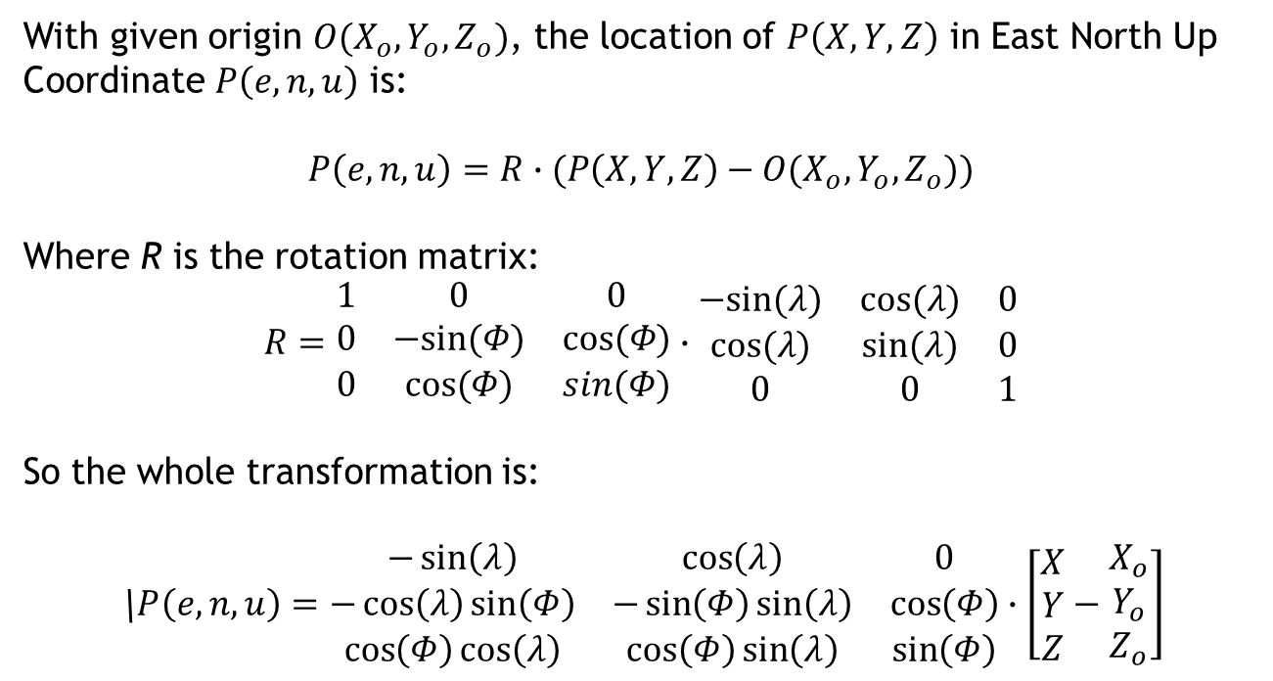
Coordinate Transformations: ECEF → ENU:-
With given origin $O(X_{o},Y_{o},Z_{o})$, the location of $P\left(X,Y,Z\right)$ in East North Up Coordinate $P\left(e,n,u\right)$ is:
$$P\left(e,n,u\right)=R∙(P\left(X,Y,Z\right)−O(X_{o},Y_{o},Z_{o}))$$
Where R is the rotation matrix:
$$R=\begin{matrix}1 & 0 & 0 \\ 0 & −sin⁡(Φ) & cos⁡(Φ) \\ 0 & cos⁡(Φ) & sin(Φ)\end{matrix}∙\begin{matrix}−sin⁡(λ) & cos⁡(λ) & 0 \\ cos⁡(λ) & sin⁡(λ) & 0 \\ 0 & 0 & 1\end{matrix}$$
So the whole transformation is:
\$P\left(e,n,u\right)=\begin{matrix}−\sin\left(λ\right) & \cos\left(λ\right) & 0 \\ −\cos\left(λ\right)\sin\left(Φ\right) & −\sin\left(Φ\right)\sin\left(λ\right) & \cos\left(Φ\right) \\ \cos\left(Φ\right)cos\left(λ\right) & \cos\left(Φ\right)\sin\left(λ\right) & \sin\left(Φ\right)\end{matrix}∙\left[\begin{matrix}X \\ Y \\ Z\end{matrix}−\begin{matrix}X_{o} \\ Y_{o} \\ Z_{o}\end{matrix}\right]$

Slide 11
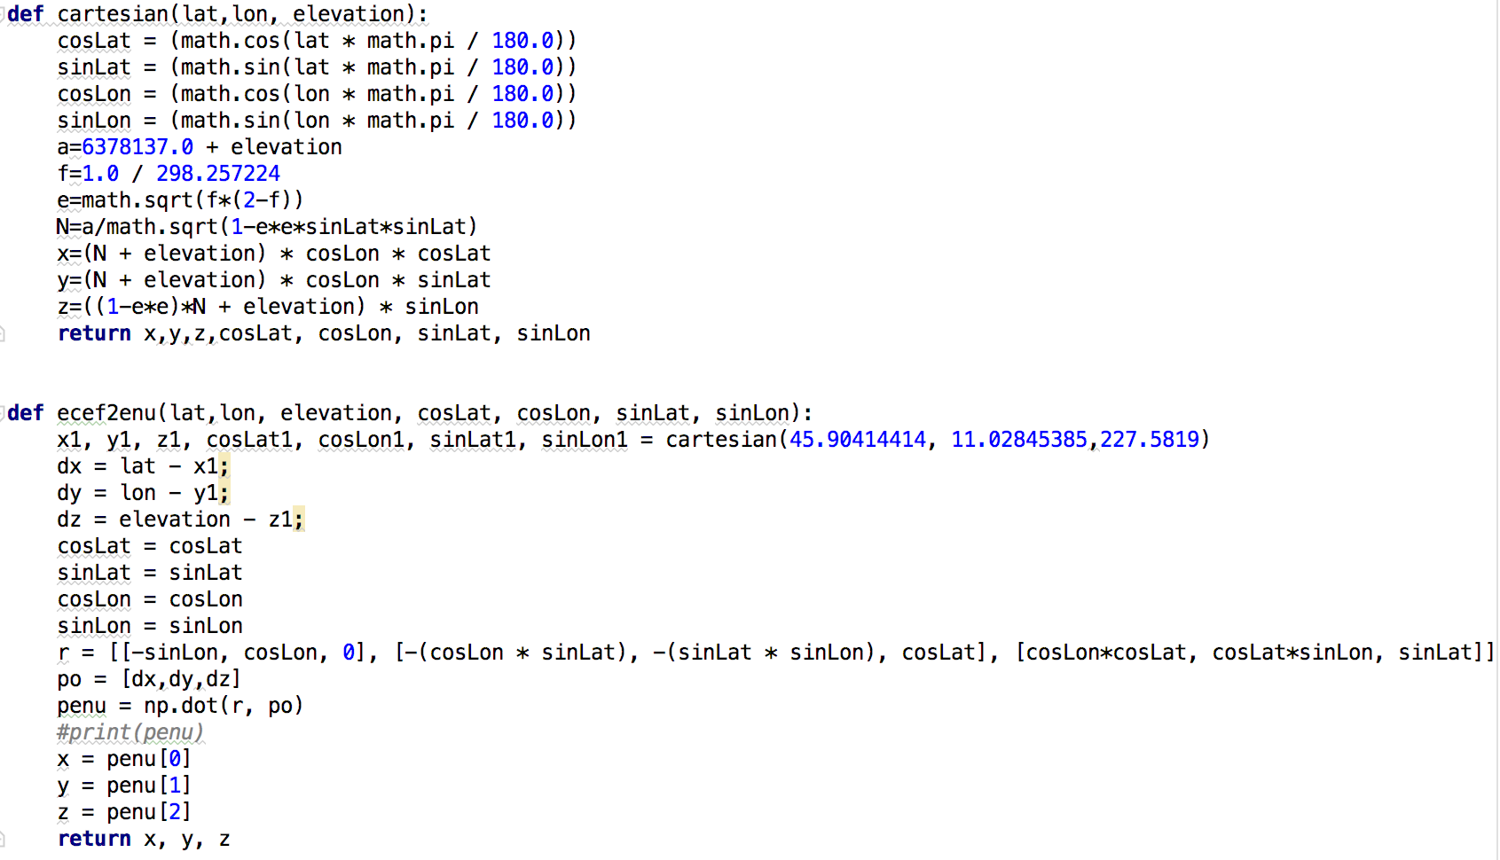
Code snippet to convert ECEF to ENU:

Slide 12
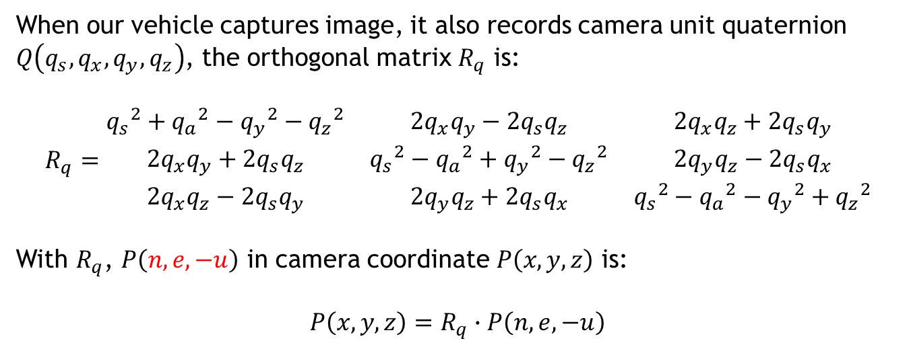
Coordinate Transformations: ENU → Camera Coordinate
When our vehicle captures image, it also records camera unit quaternion $Q\left(q_{s},q_{x},q_{y},q_{z}\right)$, the orthogonal matrix $R_{q}$ is:
$R_{q}=\begin{matrix}{q_{s}}^{2}+{q_{a}}^{2}−{q_{y}}^{2}−{q_{z}}^{2} & 2q_{x}q_{y}−2q_{s}q_{z} & 2q_{x}q_{z}+2q_{s}q_{y} \\ 2q_{x}q_{y}+2q_{s}q_{z} & {q_{s}}^{2}−{q_{a}}^{2}+{q_{y}}^{2}−{q_{z}}^{2} & 2q_{y}q_{z}−2q_{s}q_{x} \\ 2q_{x}q_{z}−2q_{s}q_{y} & 2q_{y}q_{z}+2q_{s}q_{x} & {q_{s}}^{2}−{q_{a}}^{2}−{q_{y}}^{2}+{q_{z}}^{2}\end{matrix}$
With $R_{q}$, $P\left(n,e,−u\right)$ in camera coordinate $P\left(x,y,z\right)$ is:
$$P\left(x,y,z\right)=R_{q}∙P\left(n,e,−u\right)$$

Slide 13
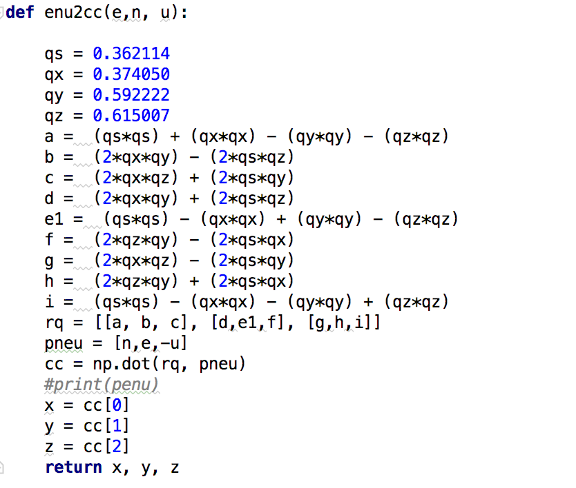
Code snippet to convert ENU to Camera Co-ordinates:

Slide 14
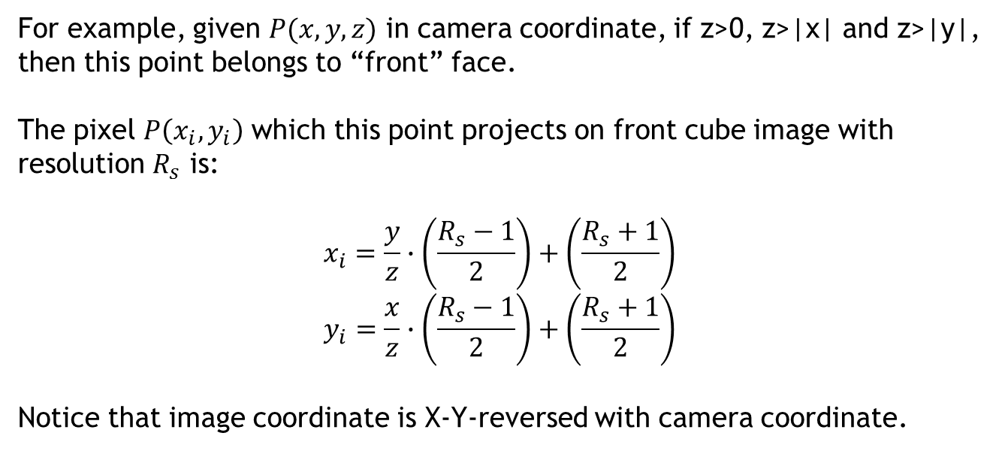
Coordinate Transformations: Camera Coordinate → Image Coordinate
For example, given $P(x,y,z)$ in camera coordinate, if z>0, z>|x| and z>|y|, then this point belongs to “front” face.
The pixel $P\left(x_{i},y_{i}\right)$ which this point projects on front cube image with resolution $R_{s}$ is:
$$x_{i}=\frac{y}{z}∙\left(\frac{R_{s}−1}{2}\right)+\left(\frac{R_{s}+1}{2}\right)$$
$$y_{i}=\frac{x}{z}∙\left(\frac{R_{s}−1}{2}\right)+\left(\frac{R_{s}+1}{2}\right)$$
Notice that image coordinate is X-Y-reversed with camera coordinate.

Slide 15
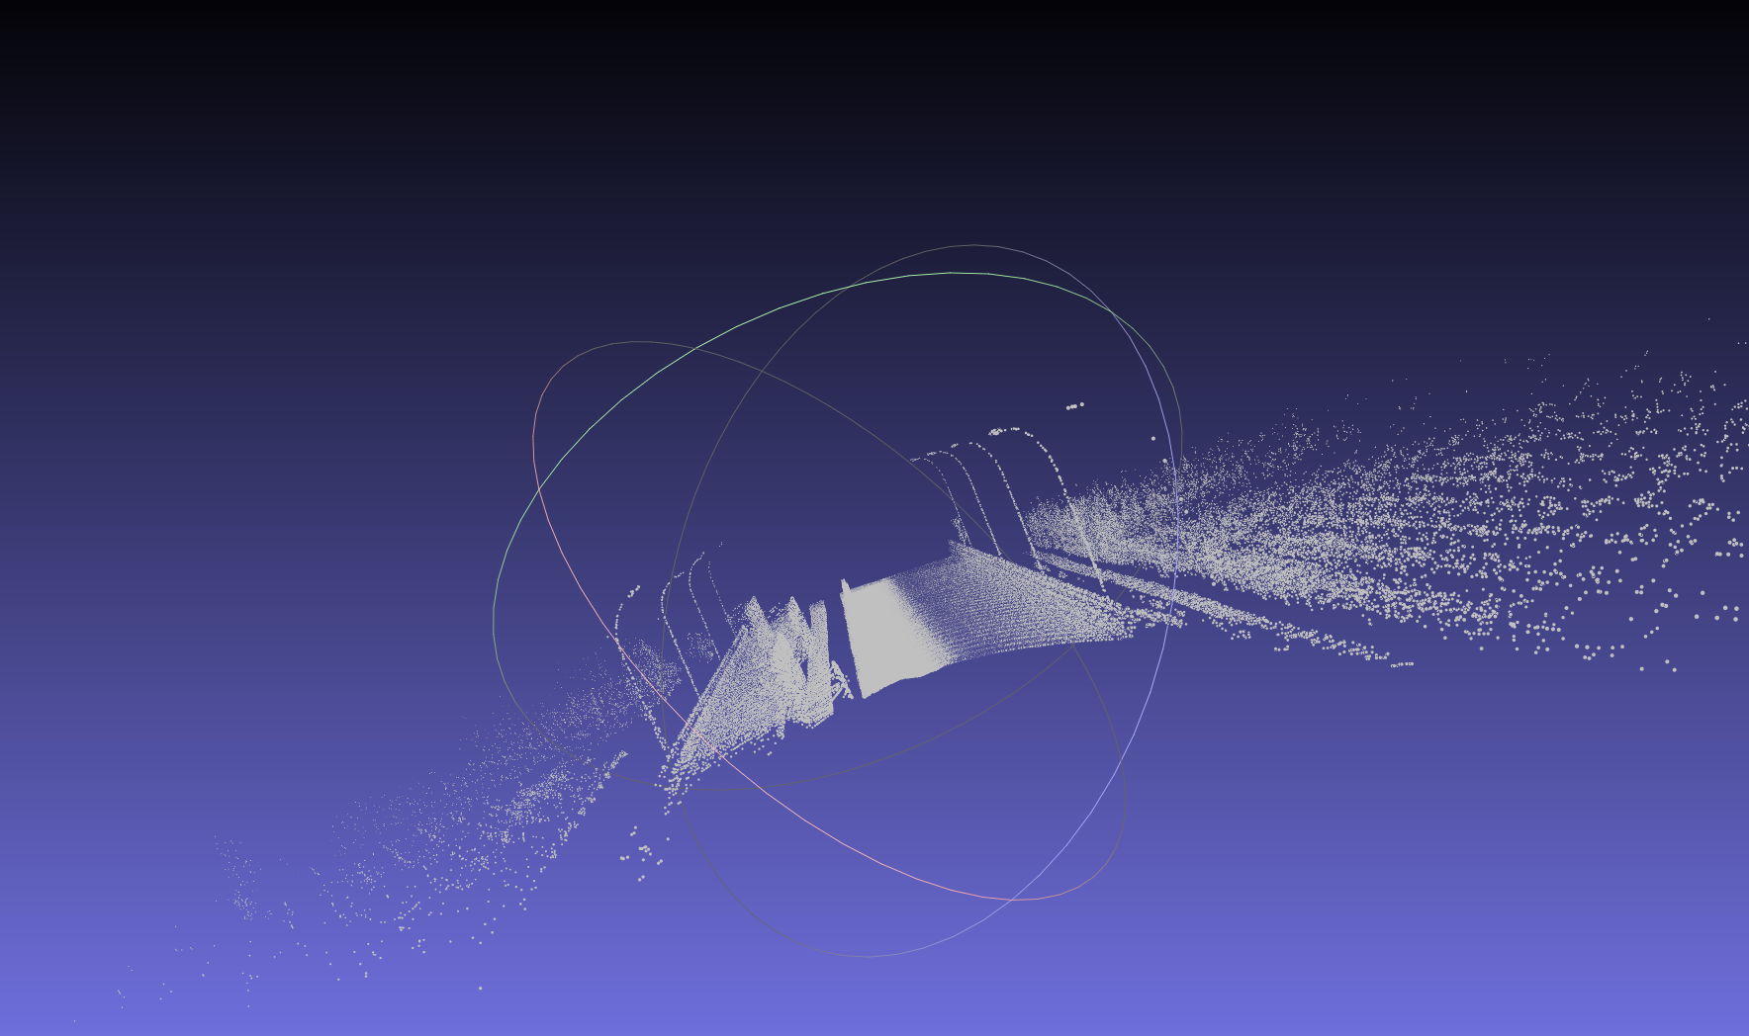
Point Cloud Visualisation of using Mesh Lab:
Camera co-ordinates cube:

Slide 16
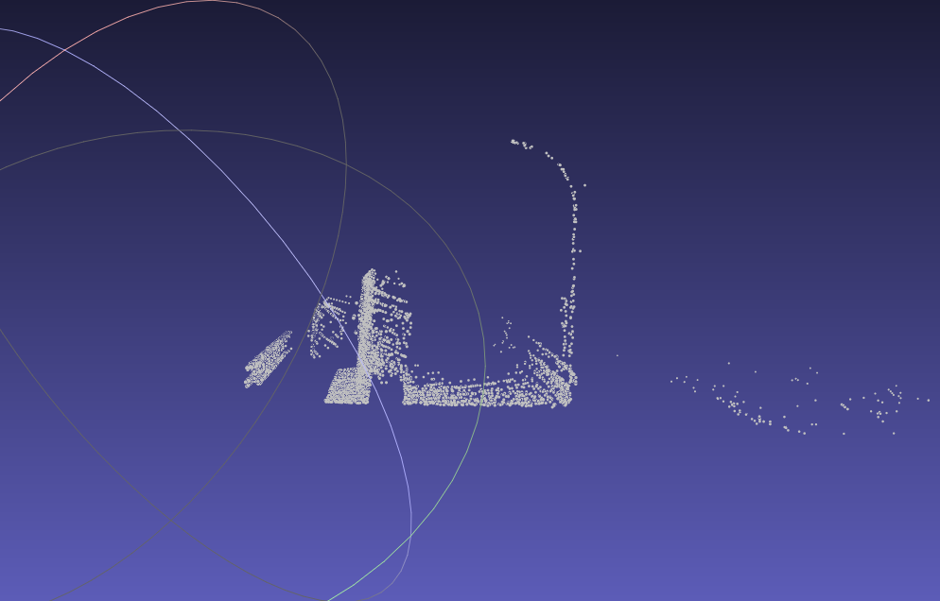
Front face of previous cube (point cloud representation):

Slide 17
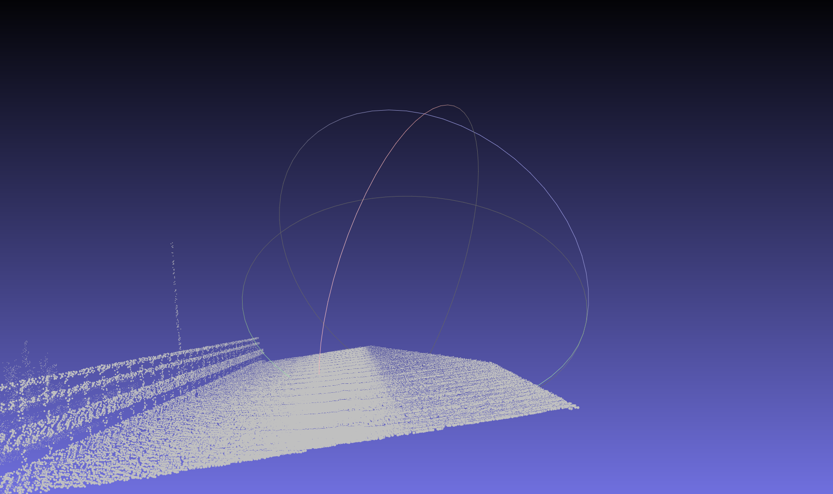
Back face of the cube (Point Cloud):

Slide 18
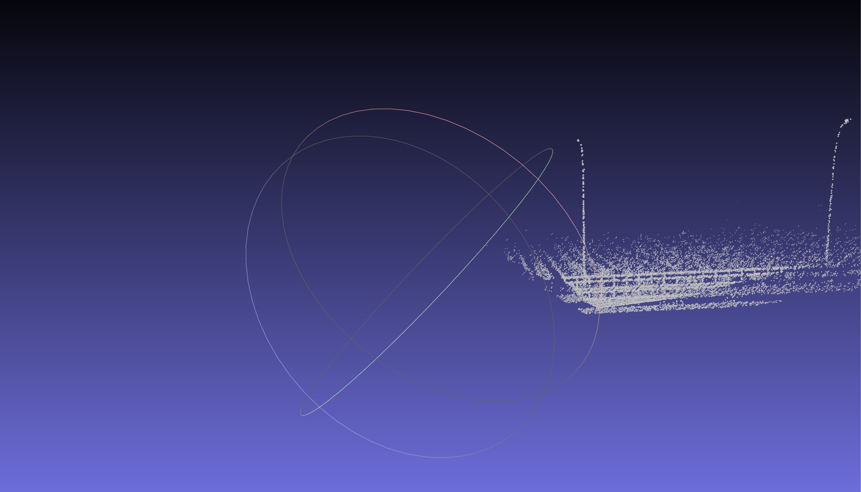
Left face of the cube (Point Cloud):

Slide 19
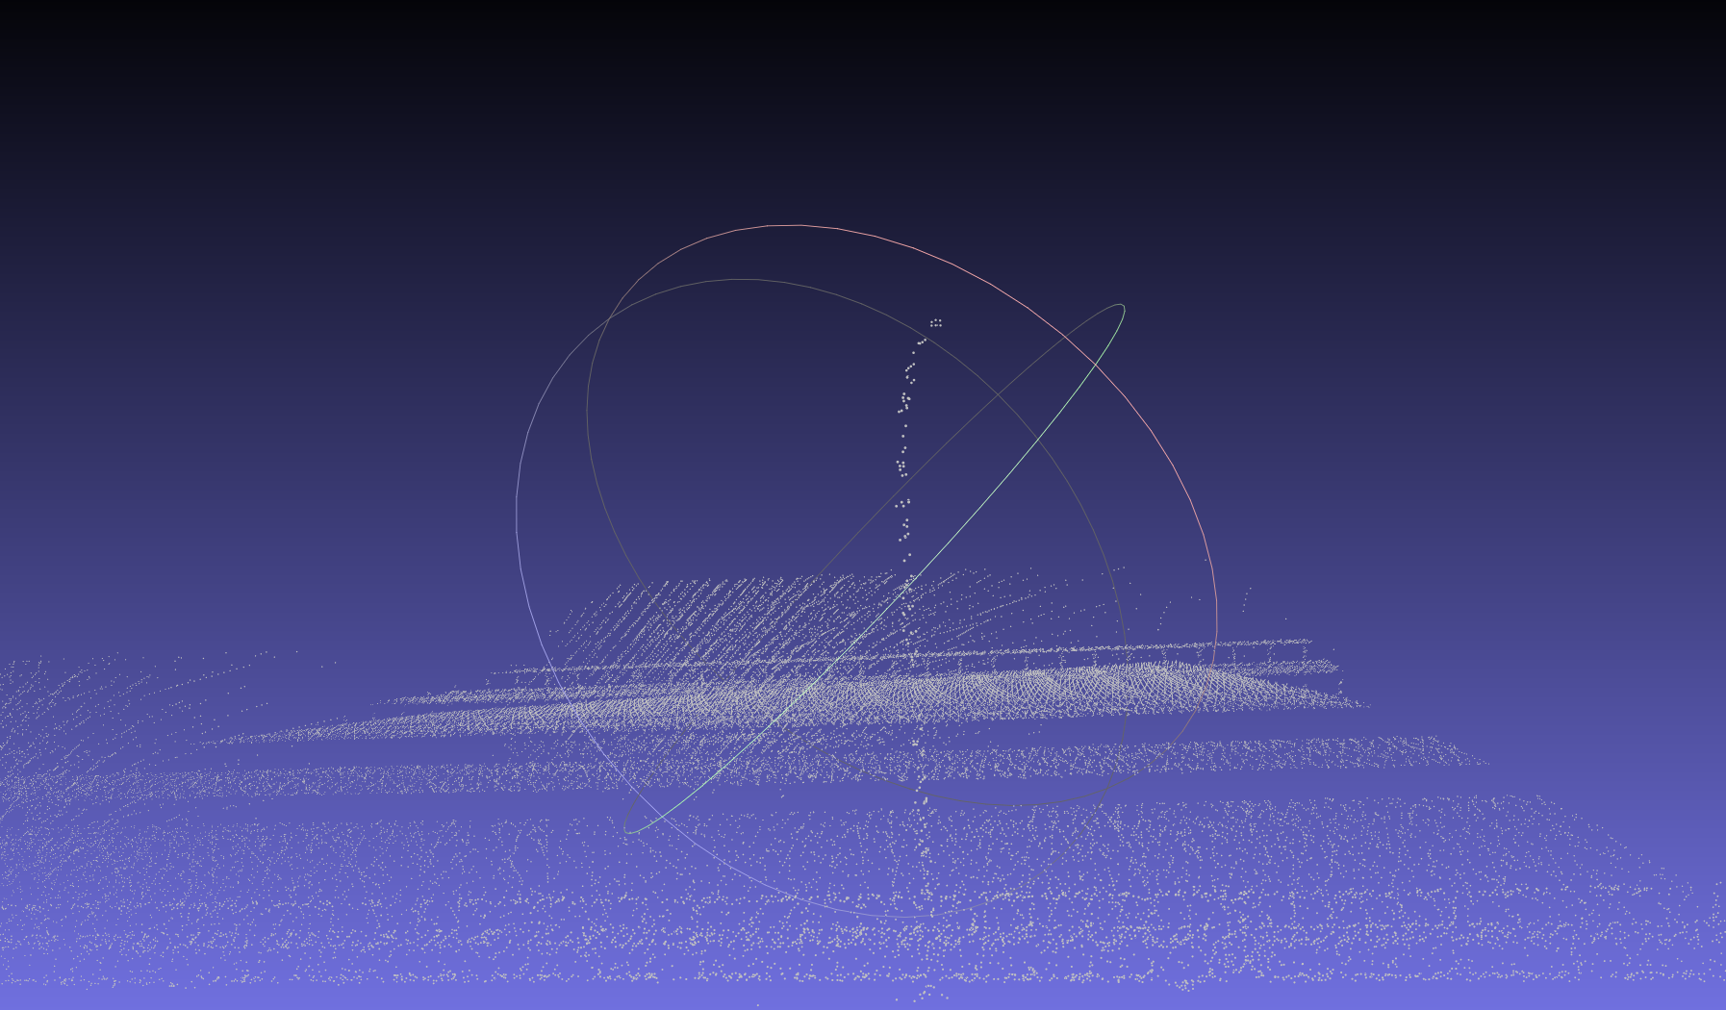
Right face of the cube (Point Cloud):

Slide 20
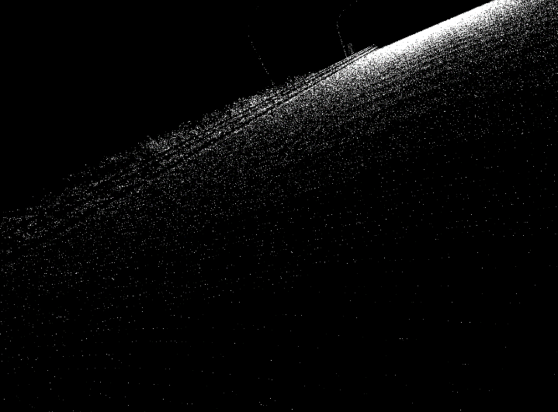
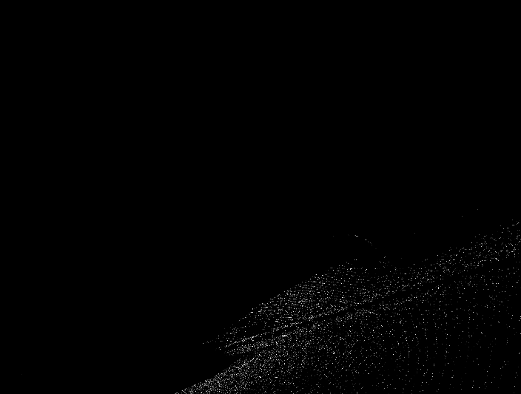
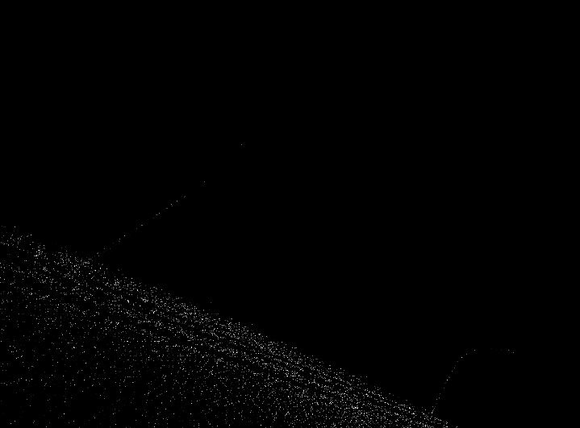
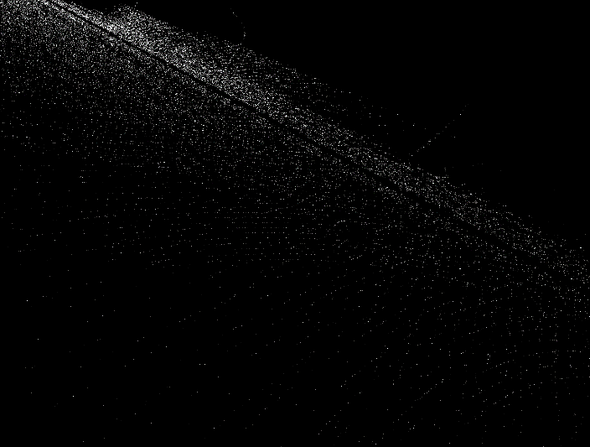
The 4 Faces of the Point Cloud obtained after transformation are:
Back Front
Left Right

Slide 21
Finding the misalignment between point cloud image and camera image:
. We have used the Brute-Force matcher with SIFT descriptors and Ratio test in OpenCV
. Brute-force matcher:
It takes the descriptor of one feature in first set and is matched with all other features in second set using some distance calculation. And the closest one is returned.

Slide 22
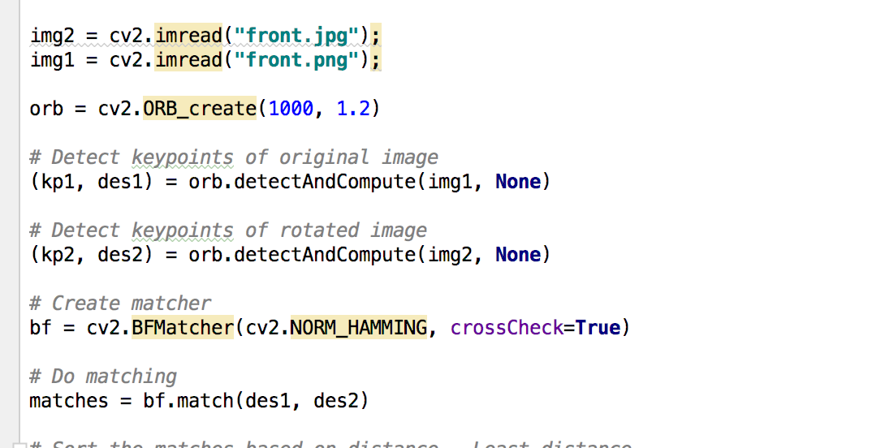
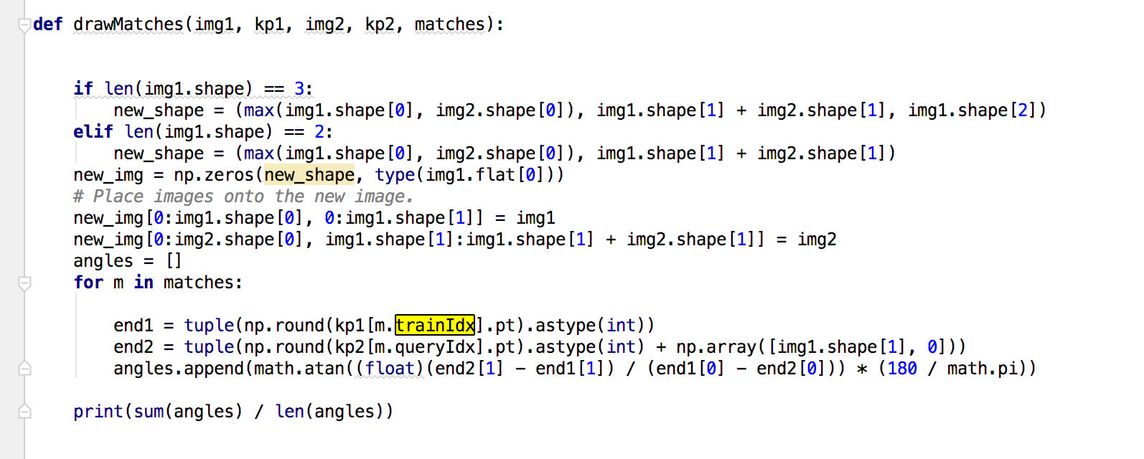
Code snippet to do the feature matching and calculate the misalignment:

Slide 23

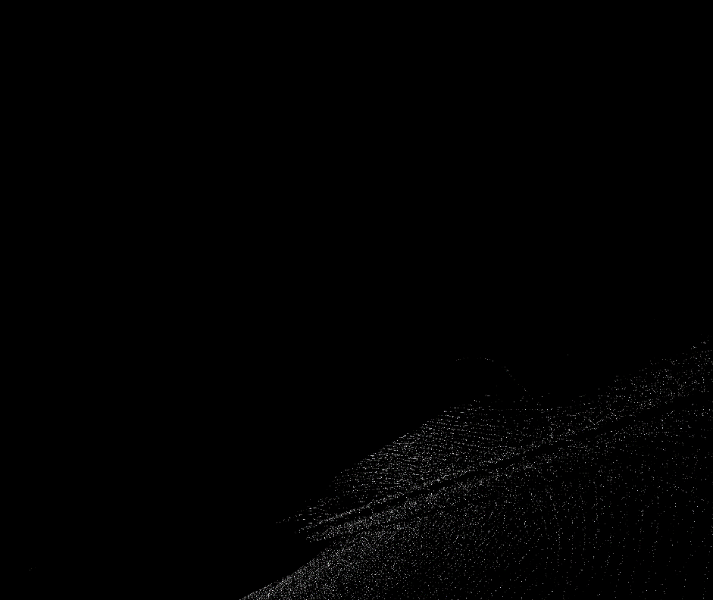
Comparing below two images to find the misalignment:
Front face (Original image) Front face (Point Cloud Visualisation)

Slide 24
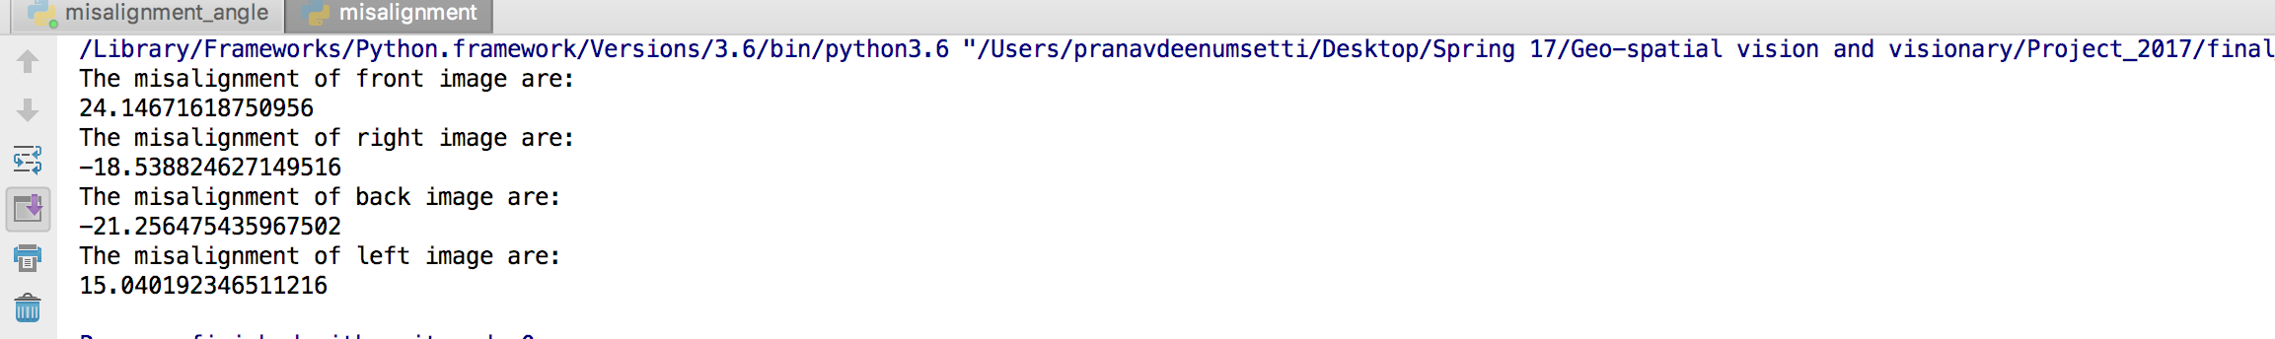
Results:-
. The misalignment values are :

Slide 25
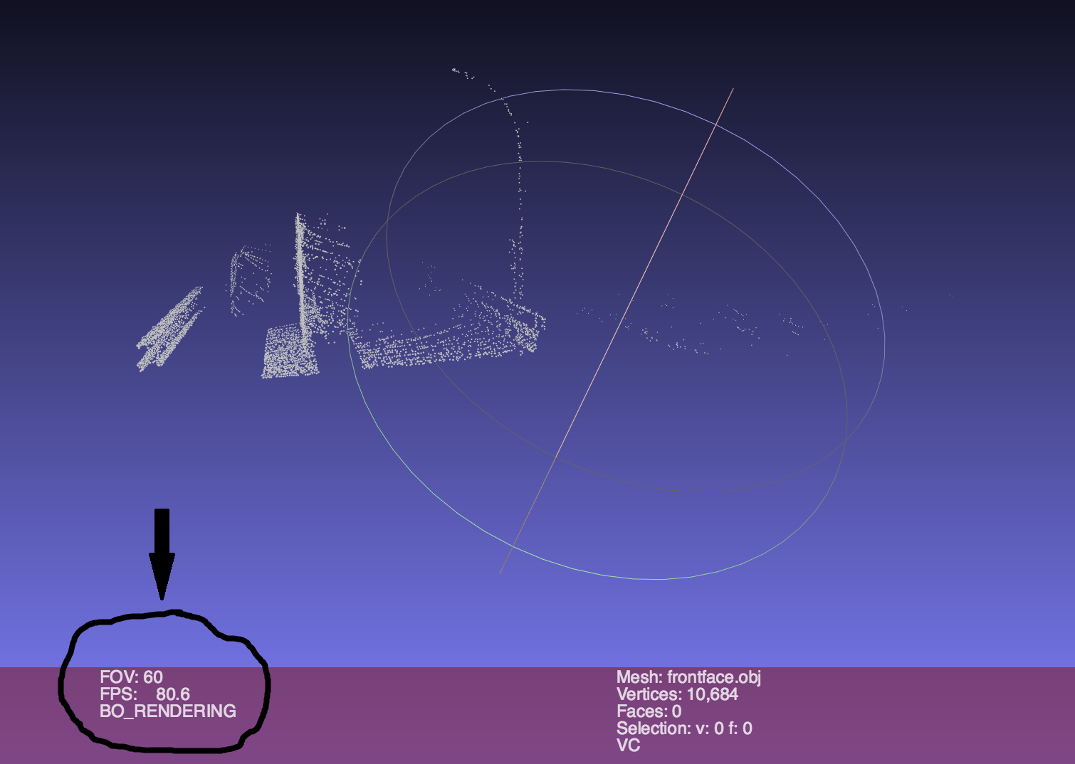

Slide 26
Result:
From the previous slide, we see that the field of view is 60 degrees instead of 90 degrees.
So, from this we can say that there is an inclination of 30 degrees.

Slide 27
Requirements & Resources:
Pycharm
NumPy
MeshLab
OpenCV

Slide 28
Recourses:
http://www.navipedia.net/index.php/Transformations_between_ECEF_and_ENU_coordinates
Co-ordinate Transformations.ppt
http://docs.opencv.org/trunk/dc/dc3/tutorial_py_matcher.html

Slide 29
THANK YOU
Submitted by:
PRANAV SAI DEENUMSETTI A20370660
KARTHIK N V A20381713
DHEERAJRAM CHANDRA A20376500
SAPTARSHI BANERJEE A20376116

